Slide 1

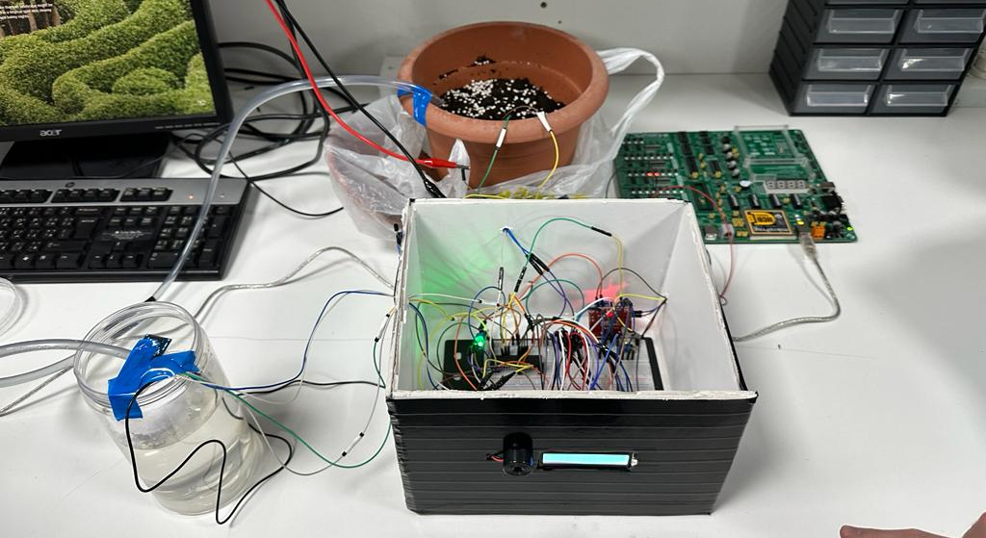
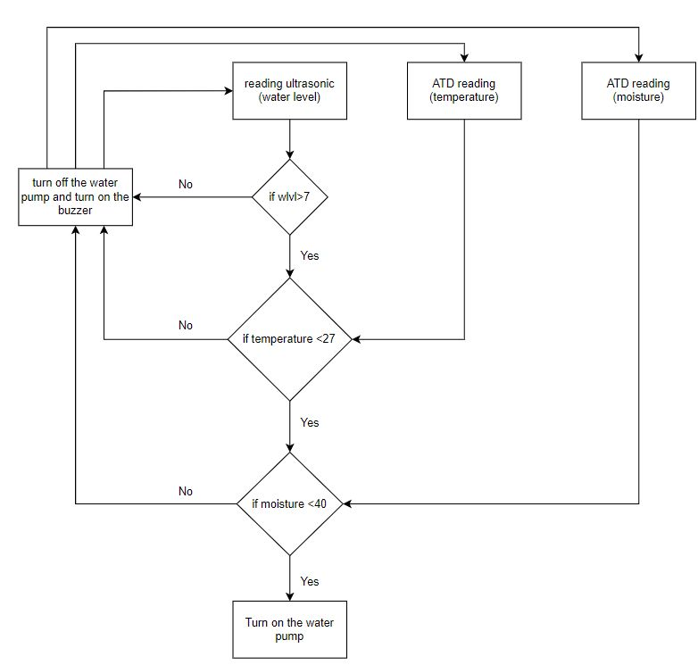
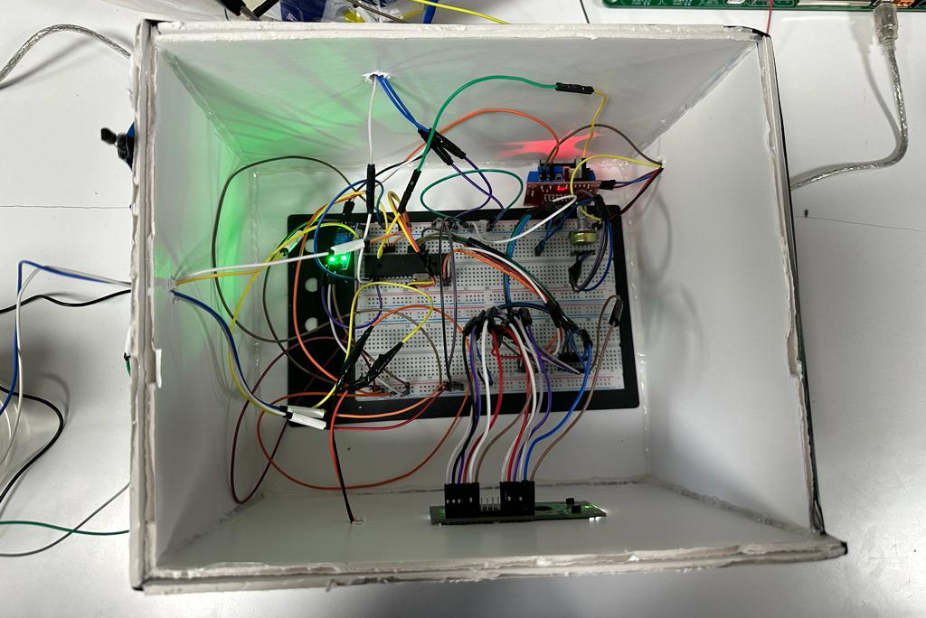
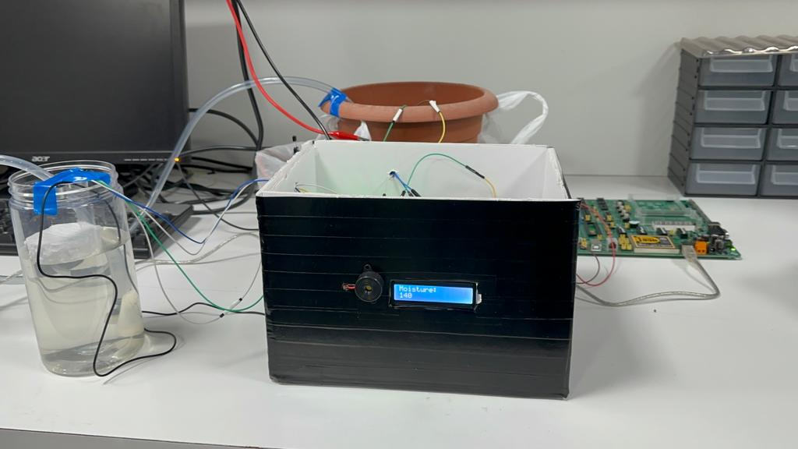
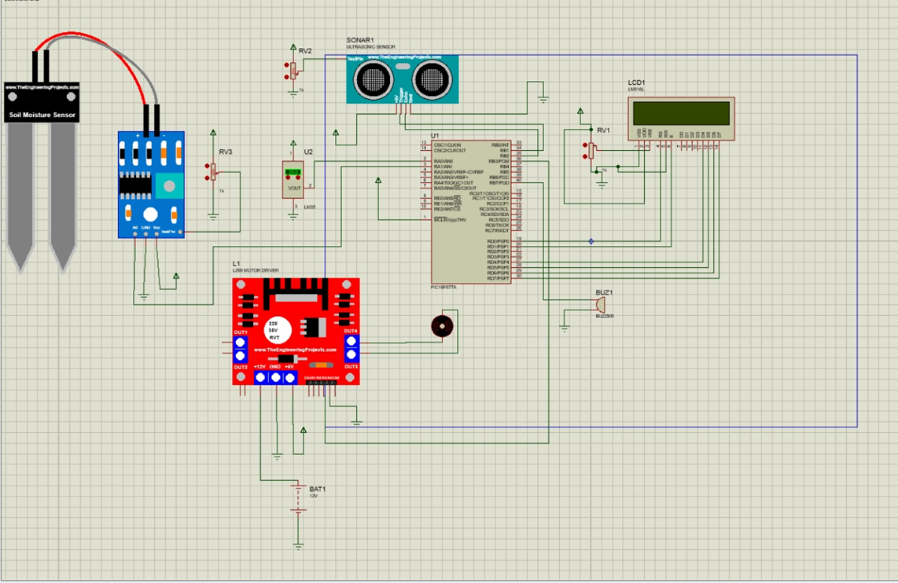
Smart Irrigation System
B.Qutob, M.Al Zu’bi and M.Khaffaf
Supervisor: Dr. Belal Sababha
Embedded Systems Final Design Project, Fall 2022
King Abdullah II School of Engineering
Princess Sumaya University for Technology
Introduction
The main goal of this project is to use moisture and temperature sensors to monitor the moisture level of the soil in both dry and wet circumstances. Our proposed design is implemented using temperature and moisture sensor to determine whether water should be sprinkled based on the conditions programmed using the microcontroller PIC16F877A. The system uses an ultrasonic sensor to determine the tank's water level and then switches an H-bridge to operate the water pump. If conditions for irrigation are meet and there’s enough water in the tank, the water pump will open, and water will flow into the soil. If the water tank is empty, a buzzer will notify the farmer that the irrigation process failed, and the water pump will close.
Results
First, the ultrasonic sensor HC-SR04 is used to check whether the water tank has enough water to irrigate the soil. If there is less than 7 cm of water in the water tank, the water pump will turn off and the buzzer will start. This will inform the farmer that the water tank needs to be refilled with water. On the other hand, if there is enough water the temperature sensor LM35 will check if air temperature is less than the suitable range. We found that the average air temperature for plants must not exceed 27 degrees Celsius. If the air temperature is above this value, the buzzer will start. If the temperature is less than 27 the moisture sensor will check whether the soil had enough moisture. After testing the sensor at different moisture levels, we found that a suitable moisture level must be less than 150.
So, to irrigate the soil the previous conditions must be achieved to turn on the water pump for 7 seconds.
Figure 3: Full Mechanical Design
Design
The system measures the water level in the tank with an ultrasonic sensor before switching an H-bridge to run the water pump. To power the PIC, sensors, and H-Bridge, respectively, we required two separate power sources. A 5 volts power source from the Easy pic was used to power the PIC microcontroller and the sensors also, a 12 volts power supply was used for the H-bridge as we needed higher power to power the water pump. The water pump will open, and water will flow into the soil if the prerequisites for irrigation are satisfied and there is enough water in the tank. A buzzer will alert the farmer that the irrigation system failed if the water tank is empty, the moisture is below 150 or if the temperature is above 27 and the water pump will shut off.
Figure 1: Flowchart diagram
Figure 2 Electrical Design using proteus software
Conclusion
The objective behind the proposed Smart Irrigation System is to assist farmers in watering their crops without the need for human intervention taking into consideration water conservation. There are a few suggestions for the project's future work that may be taken into consideration in order to improve the system and make it more effective such as connecting the system with a mobile application. Collected data can then be accessed through mobile applications. Another improvement could be adding a PH sensor analyze the amount of fertilizers found in the soil.
In conclusion, we believe that we achieved our main goal which was to use what we learned about the 16F877A microcontroller, sensors, and how to integrate everything into an embedded system. This system can help governments cooperate with the implementation of afforestation projects by providing water conservation solutions.

